Slide 1
UCSB Graduate Division Admissions and Outreach Meeting and Training Session
October 8, 2013

Slide 2
Agenda
Welcome
Outreach Calendar and Recruitment
New Transcript Policy
Procedure changes
Helping applicants
Calculating Foreign Grade Point Averages
Examples and entering information into AppReview
Viewing Unpaid Applications
Research and Faculty Interests (Now Customizable!)
Final Reminders

Slide 3
Outreach Calendar
Date | School/Conference | Location
Oct. 3-6, 2013 | SACNAS Conference | San Antonio, TX
Oct. 9, 2013 | UC San Diego Graduate School Fair | San Diego, CA
Oct. 15, 2013 | UC Santa Cruz Graduate School Fair | Santa Cruz, CA
Oct. 16, 2013 | UC Berkeley Graduate School Fair | Berkeley, CA
Oct. 24, 2013 | UC Davis Graduate School Fair | Davis, CA
Oct. 26, 2013 | Diversity Forum (St. Mary’s College) | Moraga, CA
Oct. 28, 2013 | CSU Northridge Graduate School Fair | Northridge, CA
Oct. 29, 2013 | UC Irvine Graduate School Fair | Irvine, CA
Oct. 30, 2013 | UC Los Angeles Graduate School Fair | Westwood, CA
Oct. 31, 2013 | UC Riverside Graduate School Fair | Riverside, CA
Nov. 5, 2013 | CSU Los Angeles Graduate School Fair | Los Angeles, CA
Nov. 7, 2013 | UC Santa Barbara Graduate School Fair | Santa Barbara, CA
Nov. 13-17, 2013 | ABCRMS Conference | Nashville, TN
March 1, 2014 | McNair Conference | College Park, MD
April 26, 2014 | Diversity Forum (Cal Poly Pomona) | Pomona, CA
June 1, 2014 | McNair Conference | Atlanta, GA

Slide 4
Outreach Calendar and Recruitment
Questions?

Slide 5
New Transcript Policy
Applicants are required to upload an official transcript to each educational institution they enter into their EApp.
If an applicant needs help uploading you will need to create a new institution for them, enter the required information, and upload the transcript.
If you find an applicant has uploaded the wrong transcript or forgot to redact their SSN you will need to upload a new transcript for them.

Slide 6
The redesigned edit page for Institutions

Slide 7
The redesigned edit page for Institutions
Notes:
1. You can sort institutions into the proper order.
2. You can view unofficial and/or official (if available) transcripts
3. You can edit the details of the institution and upload a new transcript using the Edit button
4. You can start a new institution

Slide 8
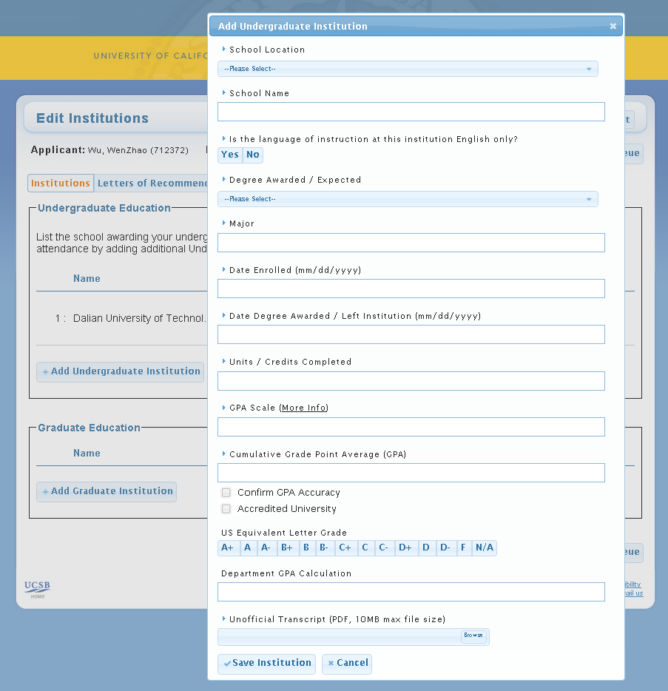
Here is where to edit institution details and upload an unofficial transcript
If a transcript is already available there will be an option to view the transcript and also to upload a new one (deleting the old one).
If you receive an official transcript from an admitted applicant send it to the Graduate Division. We will upload it to the application.
Notes:
Upload unofficial transcript
Send official transcripts of ADMITTED applicants to the Graduate Division

Slide 9
New Transcript Policy
The Graduate Division will scan and upload final/official transcripts for all admitted, SIRed applicants.
Final/Official transcripts will be available for you to view on AppReview.
For admitted, SIRed applicants we will be accepting official, electronic transcripts. Applicants are instructed to have these sent to transcripts@graddiv.ucsb.edu.

Slide 10
New Transcript Policy
Questions?

Slide 11
Calculating Foreign GPAs
Review of calculating a cumulative GPA for applicants from foreign institutions.
Example: Beijing University of Posts and Telecommunications

Slide 12
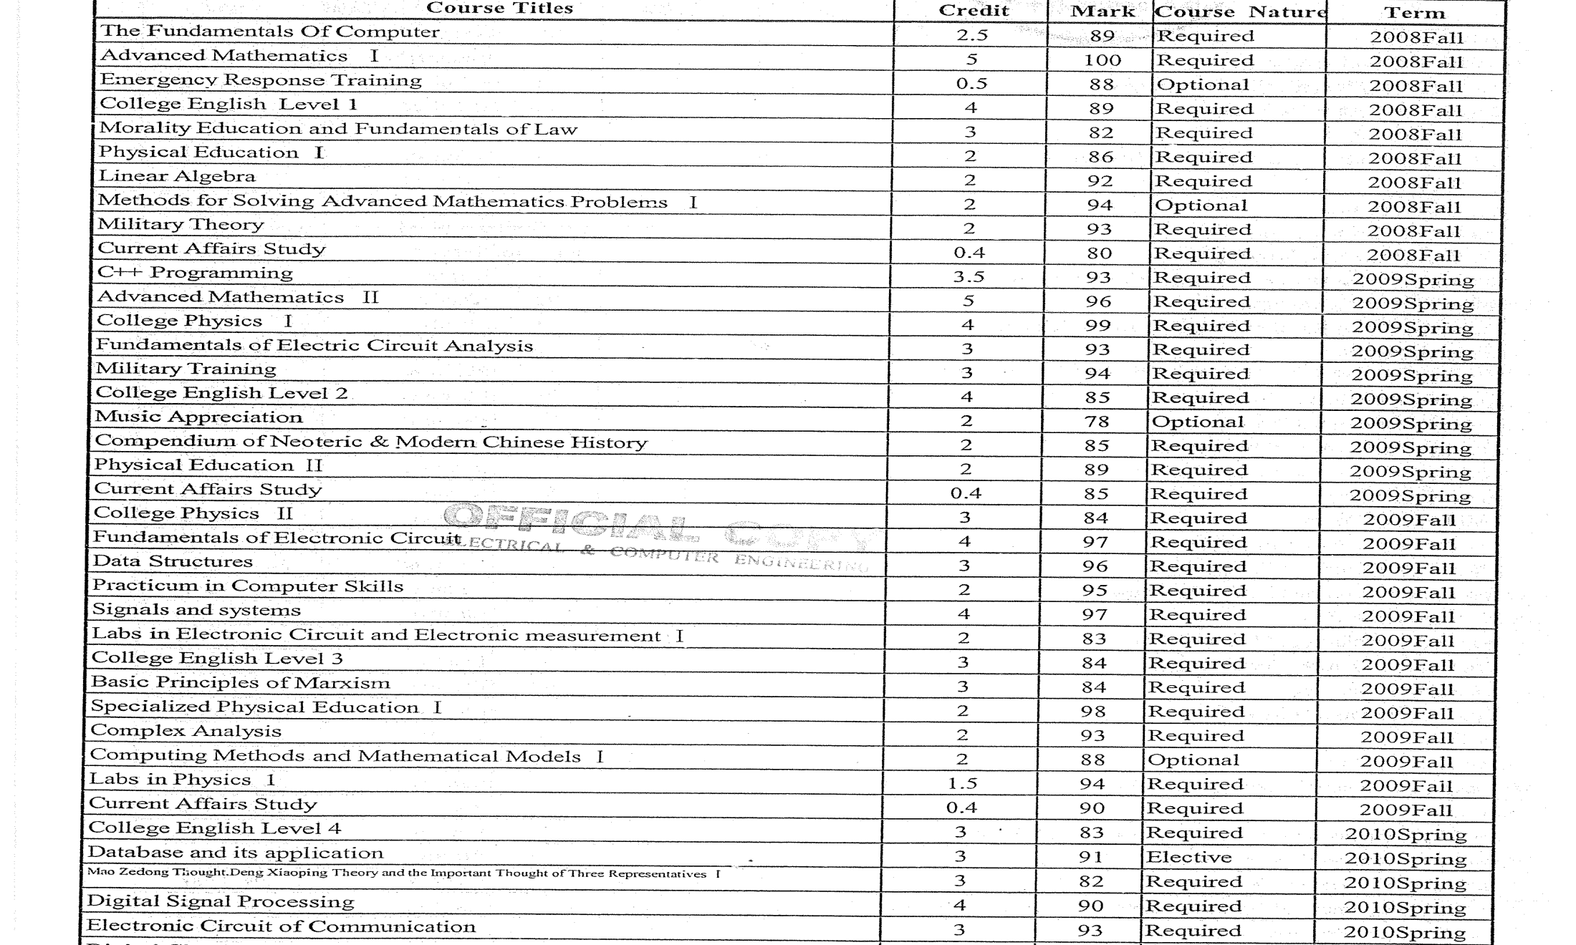
Beijing University of Posts and Telecommunications Transcript

Slide 13
Beijing University of Posts and Telecommunications Transcript
Enter Credits/Units Here
Enter Records/Marks/Grades Here
Note on using the spreadsheet: Only delete the numbers in the Credit and Record Columns. All other areas have formulas!

Slide 14
Beijing University of Posts and Telecommunications Transcript
This is the number that goes into AppReview.

Slide 15
Beijing University of Posts and Telecommunications Transcript
Enter total units (obtained from the spreadsheet)
181
Enter GPA scale (NOT 4.0 unless the institution uses a 4.0 scale)
100
Enter the cumulative GPA you calculated. And check the boxes indicating you’ve confirmed accreditation and GPA accuracy.
89.86
Choose an equivalent US letter grade. Obtained from the Country Guide (next slide).
Optional: enter a Department Calculation (on a 4.0 scale, major GPA, etc.)

Slide 16
Determining US Letter Grade Equivalency from Country Guide
This is China’s Grading Scale. Anything 80% or higher does not need an exception.

Slide 17
Calculating Foreign GPAs
Questions?

Slide 18
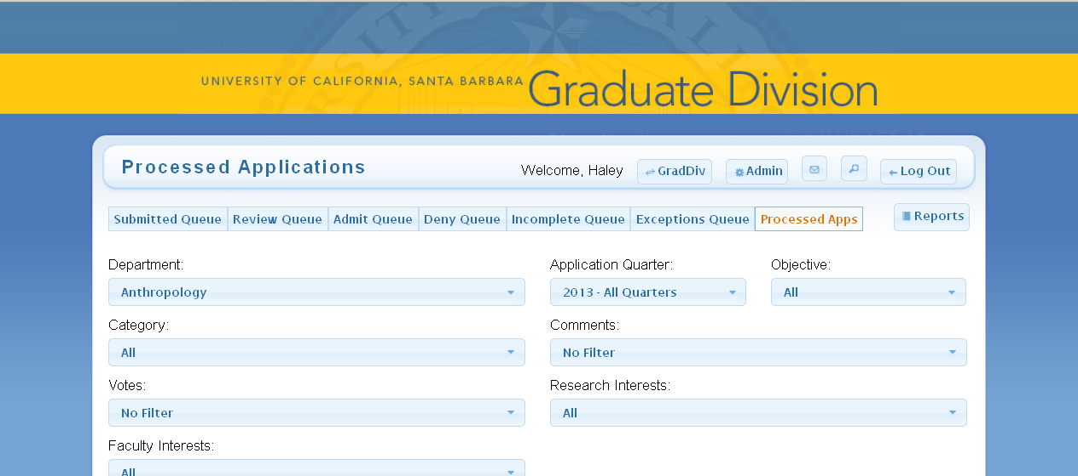
Searching and Viewing Unpaid and Partial Applications
Use the search function.

Slide 19
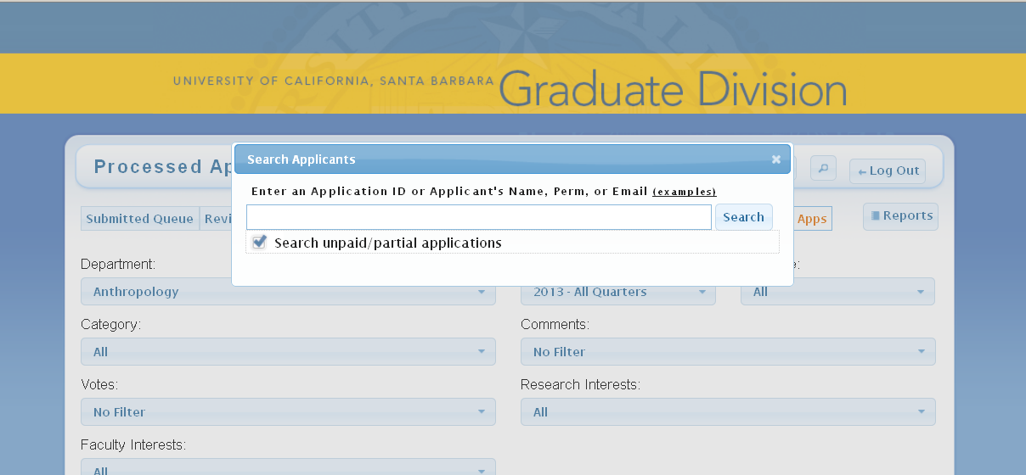
Searching and Viewing Unpaid and Partial Applications
Enter a name, perm, etc. and check the box.

Slide 20
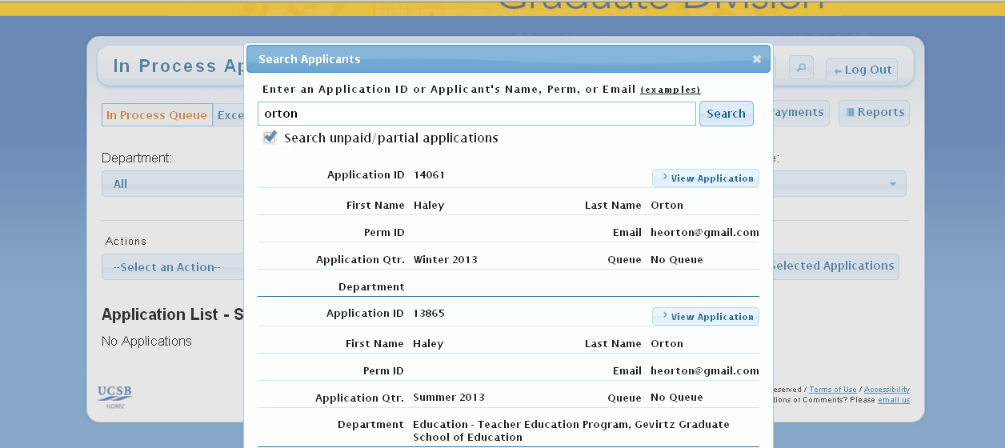
Searching and Viewing Unpaid and Partial Applications
Select the application you want to view.

Slide 21
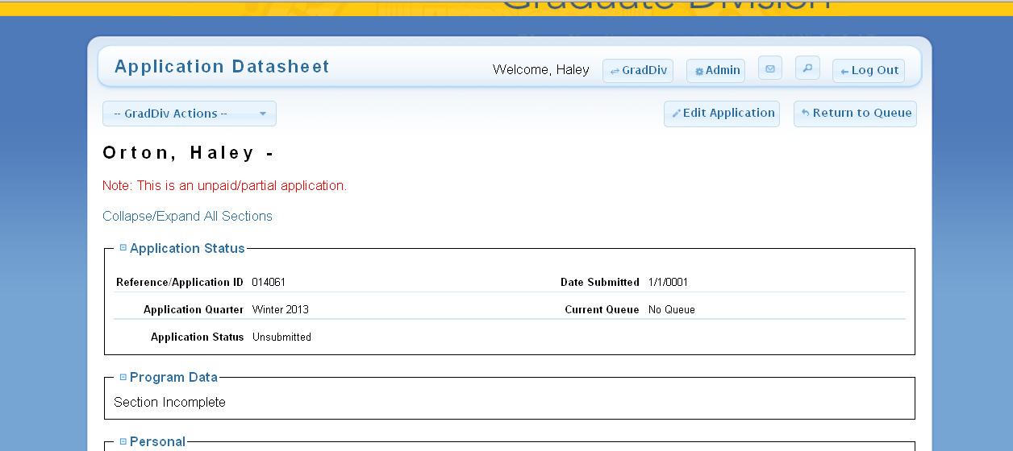
Searching and Viewing Unpaid and Partial Applications
Note: Only Application Administrators have access to unpaid/partial applications. These applications should not be released to other users under any circumstance. It is important to remember that these applicants may never pay or choose to release their application for review.

Slide 22
Searching and Viewing Unpaid and Partial Applications
Questions?

Slide 23
Research and Faculty Interests (Now Customizable!)
Enter the minimum and maximum number of research/faculty interests you would like your applicants to select.
The EApp now instructs applicants to prioritize their selections.

Slide 24
Research and Faculty Interests (Now Customizable!)
Questions?

Slide 25
A Few Final Things…
New: Comments to applicant triggers email notification
Reminder: New admissions manual on GradNet
Please contact us for additional training, meeting with faculty, etc. We want to be involved!
Other announcements?

Slide 26
Thank you!

